Slide 1
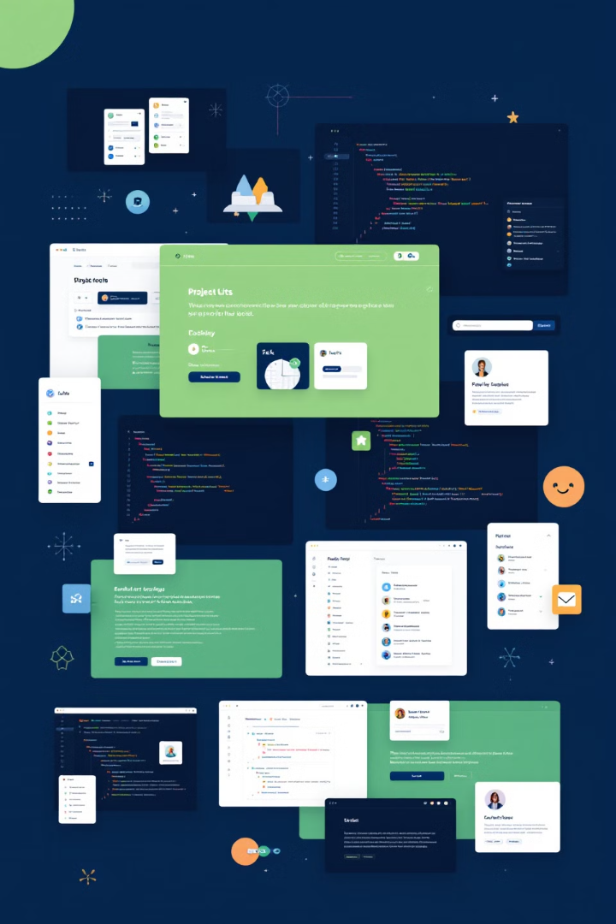
Web Development Project Documentation Template
Add the screenshots and explain each part of your website, You may use this template and recreate the current image by adding your one in or you create your own one, ensuring you have added all the features of your website and your GitHub Repository Link.

Slide 2
Homepage
Purpose
Key features
Visual appeal

Slide 3
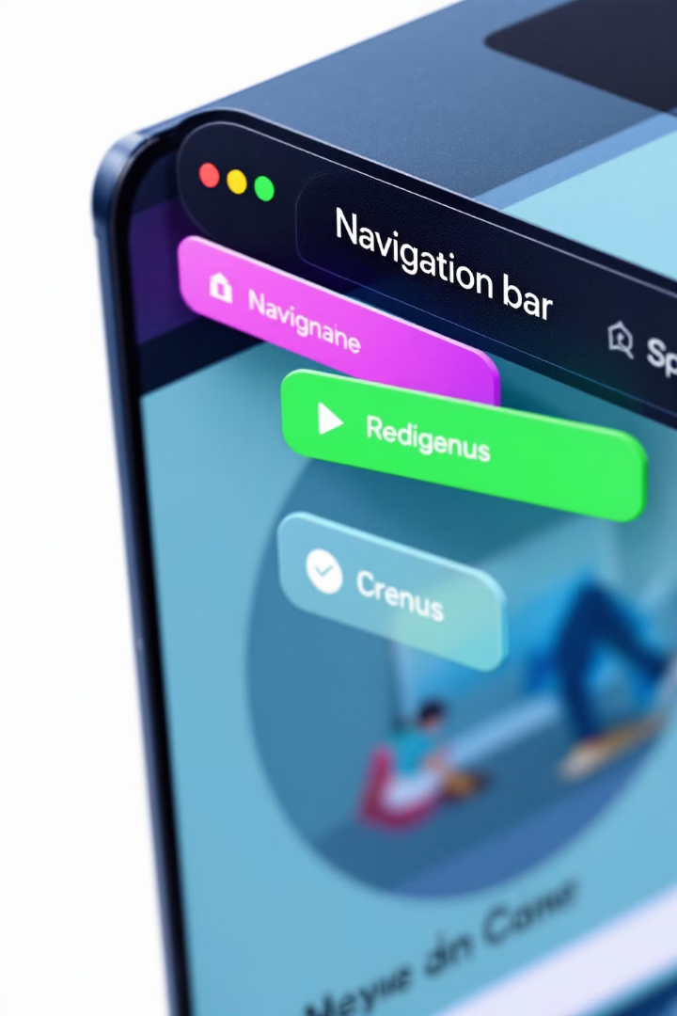



Navigation Bar
Links included
User experience
Responsive design

Slide 4
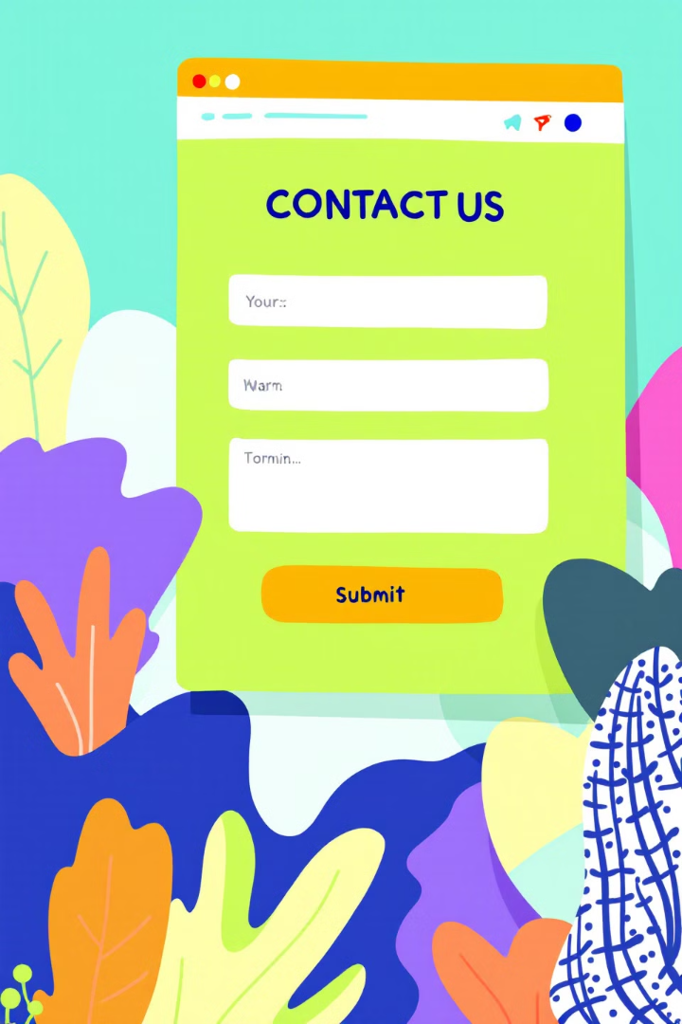
Contact Us Page
Form fields
Input validation
Firebase integration

Slide 5
Firebase Integration
Functionality enhancement
Data storage process

Slide 6




Responsive Design
Desktop view
Mobile view
CSS techniques

Slide 7
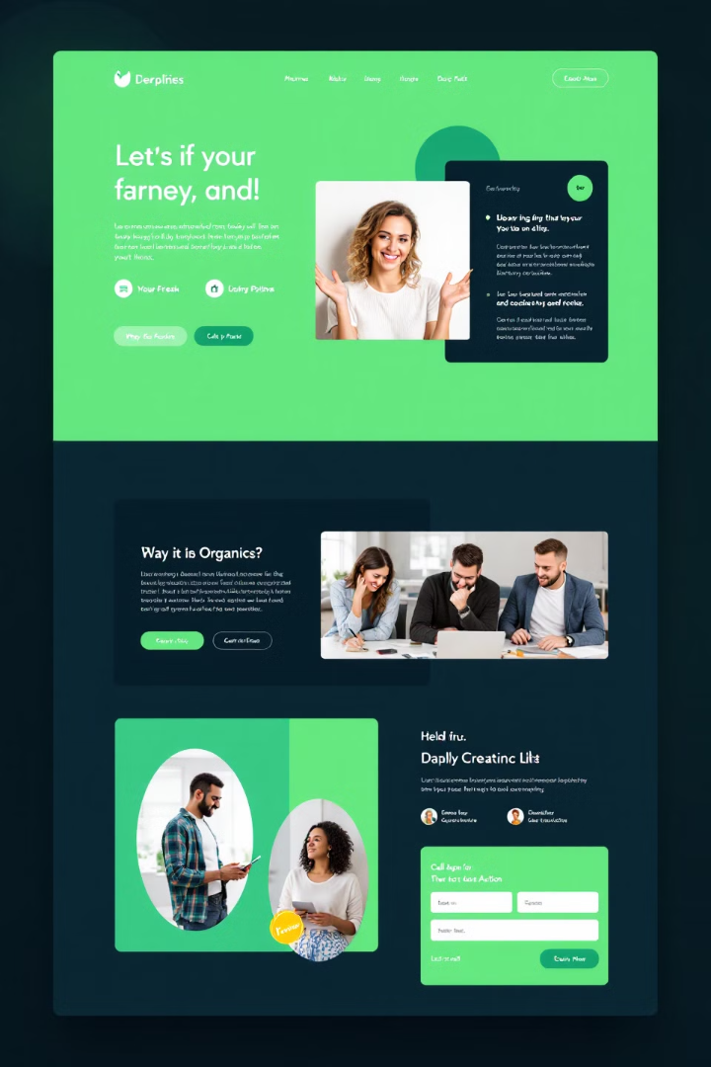
Styling with CSS
1
Color scheme
2
Typography
3
Layout

Slide 8
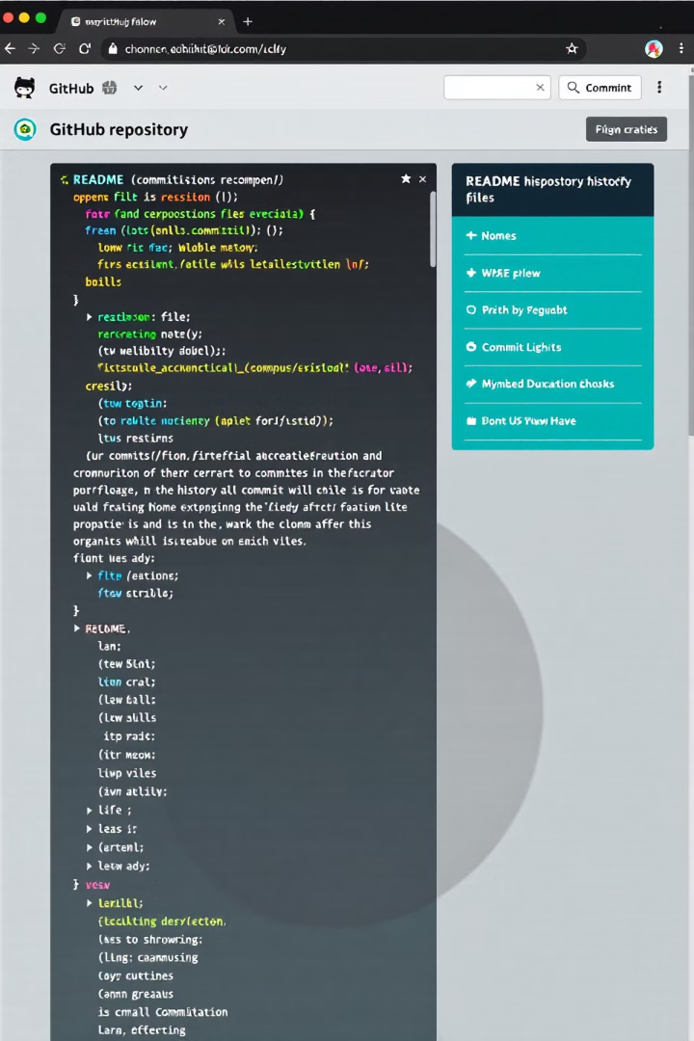
GitHub Repository
README contents

Slide 9



Reflection and Challenges
1
Learning experience
2
Challenges faced
3
Proud achievements

Slide 10
References
Pictures taken from chatgpt
List links, resources, and images used in the project

Slide 11

Instructions for Students
1
2
Fill out slides
Include references
3
Submit presentation

